Slide 1
COMPUTER NETWORKS – PART 10

Slide 2
What is Flow Control?
Flow control is a technique that allows two stations working at different speeds to communicate with each other.
It is a set of measures taken to regulate the amount of data that a sender sends so that a fast sender does not overwhelm a slow receiver.
Flow control in Data Link Layer simply restricts and coordinates number of frames or amount of data sender can send just before it waits for an acknowledgement from receiver.
The receiver needs a buffer for storing data or frames until they are processed.
Flow Control is classified into two categories:
Feedback based Flow Control: In these protocols, the sender sends frames after it has received acknowledgments from the user.
Rate based Flow Control: These protocols have built in mechanisms to restrict the rate of transmission of data without requiring acknowledgment from the receiver.

Slide 3
What is Error Control?
Error control in data link layer is the process of detecting and correcting data frames that have been corrupted or lost during transmission.
Data link layer follows a technique to detect transit errors and take necessary actions, which is retransmission of frames whenever error is detected or frame is lost. The process is called Automatic Repeat Request (ARQ).

Slide 4
Phases in Error Control
The error control mechanism in data link layer involves the following phases.
Detection of Error − Transmission error, if any, is detected by the receiver and notified to the sender.
Acknowledgment − acknowledgment may be positive or negative.
Positive ACK − On receiving a correct frame, the receiver sends a positive acknowledge.
Negative ACK − On receiving a damaged frame or receiving no frame, the receiver sends a negative acknowledgment back to the sender.
Retransmission − The sender maintains a clock and sets a timeout period. If an acknowledgment of a data-frame previously transmitted does not arrive before the timeout, or a negative acknowledgment is received, the sender retransmits the frame.

Slide 5
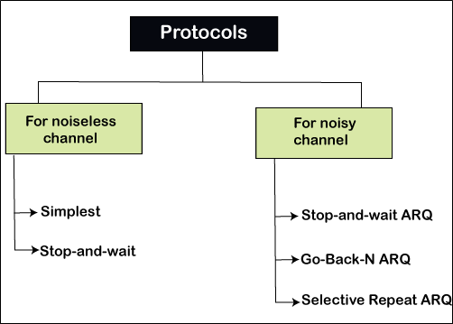

Slide 6
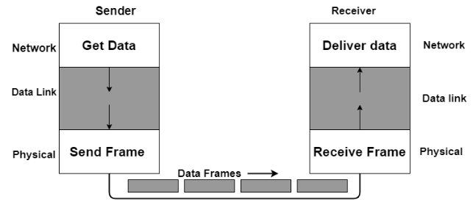
Simplest Protocol – no flow control or error control
Simplest Protocol is a protocol that neither has flow control nor has error control. This can be used in noiseless channels.
The simplest protocol is basically a unidirectional protocol in which data frames only travel in one direction; from the sender to the receiver.
In this, the receiver can immediately handle the frame it receives whose processing time is small enough to be considered as negligible.

Slide 7
Stop and Wait Protocol – only flow control
Stop and wait protocol can be used in noiseless channels.
Sender side
Rule 1: Sender sends one data packet at a time.
Rule 2: Sender sends the next packet only when it receives the acknowledgment of the previous packet.
Receiver side
Rule 1: Receive and then consume the data packet.
Rule 2: When the data packet is consumed, receiver sends the acknowledgment to the sender.

Slide 8
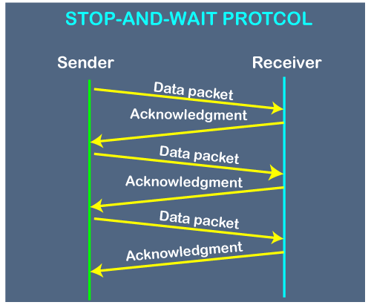

Slide 9
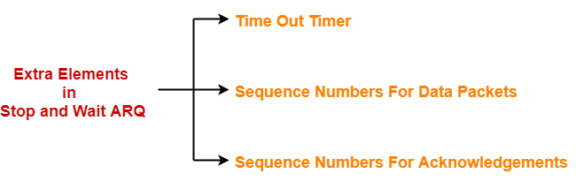
Stop and Wait ARQ Protocol – flow control and error control
Stop and wait ARQ protocol can be used in noisy channels.
A stop-and-wait ARQ sender sends one frame at a time.
Stop-and-wait ARQ is a special case of the general sliding window protocol with transmit and receive window sizes equal to one in both cases.
The sliding window is a technique for sending multiple frames at a time. It controls the data packets between the two devices where reliable and sequential delivery of data frames is needed.

Slide 10
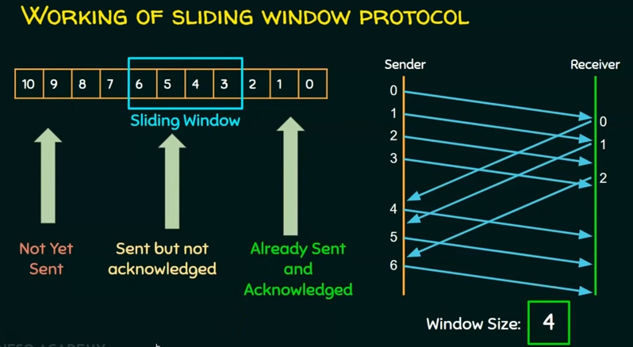
Sliding Window Protocol sends multiple frames at a time. Number of frames to be sent is based on the window size. Each frame is numbered.

Slide 11
Stop and wait ARQ is a one bit sliding window protocol where-
Sender window size = 1
Receiver window size = 1
Minimum number of sequence numbers required = Sender Window Size + Receiver Window Size = 1 + 1 = 2
Minimum number of sequence numbers required in Stop and Wait ARQ = 2.
The two sequence numbers used are 0 and 1.

Slide 12
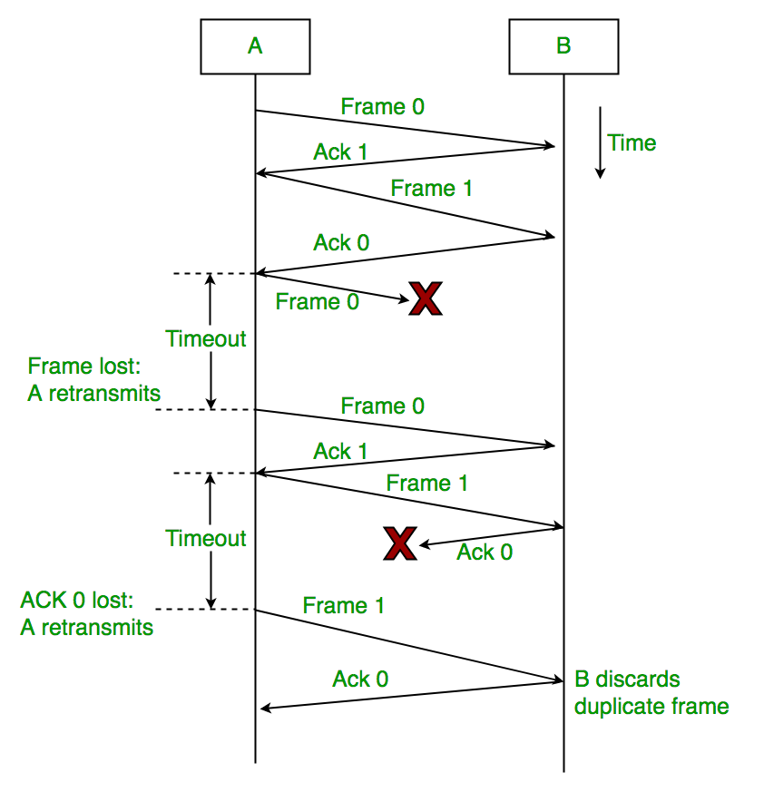

Slide 13
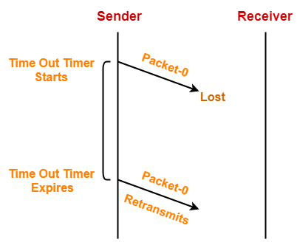
1. Problem of Lost Data Packet-
Time out timer helps to solve the problem of lost data packet.
After sending a data packet to the receiver, sender starts the time out timer.
If the data packet gets acknowledged before the timer expires, sender stops the time out timer.
If the timer goes off before receiving the acknowledgement, sender retransmits the same data packet. After retransmission, sender resets the timer.

Slide 14
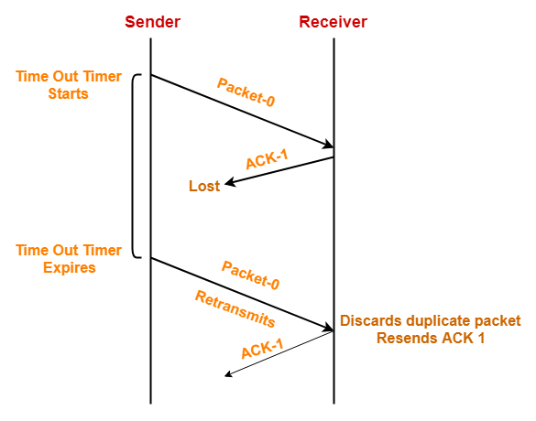
2. Problem of Lost Acknowledgement
Sequence number on data packets help to solve the problem of delayed acknowledgement.
Consider the acknowledgement sent by the receiver gets lost.
Then, sender retransmits the same data packet after its timer goes off.
The sequence number on the data packet helps the receiver to identify the duplicate data packet. Receiver discards the duplicate packet and re-sends the same acknowledgement.

Slide 15
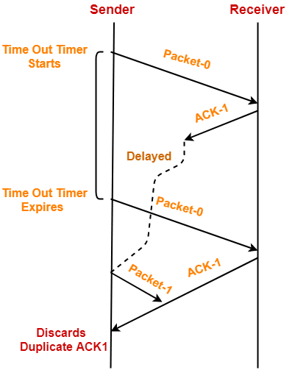
3. Problem of Delayed Acknowledgement-
Sequence number on acknowledgements help to solve the problem of delayed acknowledgement.

Slide 16
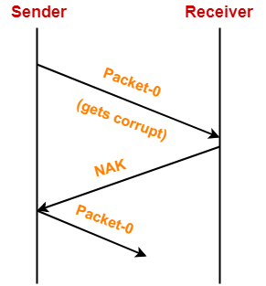
4. Problem of Damaged Packet-
If receiver receives a corrupted data packet from the sender, it sends a negative acknowledgement (NAK) to the sender.
NAK requests the sender to send the data packet again.

Slide 17
Go Back N ARQ Protocol – flow control and error control
The sending process continues to send a number of frames as specified by the window size even without receiving an acknowledgement (ACK) packet from the receiver.
The size of the sending window determines the sequence number of the outbound frames. If the sequence number of the frames is an n-bit field, then the range of sequence numbers that can be assigned is 0 to 2^{n}−1. Consequently, the size of the sending window is 2^{n}−1. The receiver window size is 1.
This protocol makes the use of cumulative acknowledgements means here the receiver maintains an acknowledgement timer; whenever the receiver receives a new frame from the sender then it starts a new acknowledgement timer. When the timer expires then the receiver sends the cumulative acknowledgement for all the frames that are unacknowledged by the receiver at that moment.

Slide 18
If the timeout timer runs out for the first frame in the window then the sender will resend all the packets in the window.
Whenever a valid acknowledgement arrives then the send window can slide one or more slots.
The sender keeps a copy of each frame until the arrival of acknowledgement.
If the receiver receives an out-of-order frame, then that frame and all the subsequent frames are discarded.
The receiver window slides when a correct frame arrives; the sliding occurs one slot at a time.
It is important to note that the new acknowledgement timer only starts after the receiving of a new frame, it does not start after the expiry of the old acknowledgement timer.

Slide 19
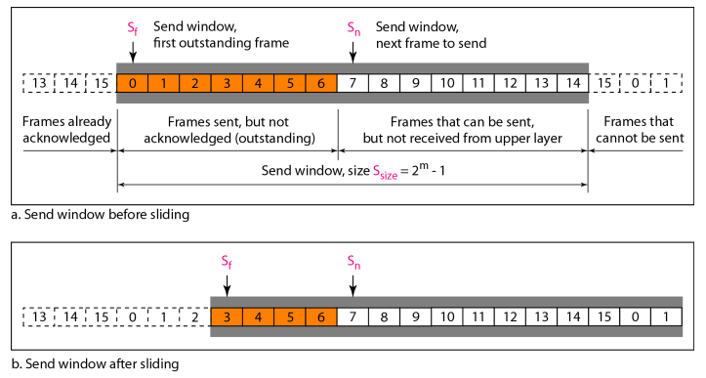

Slide 20
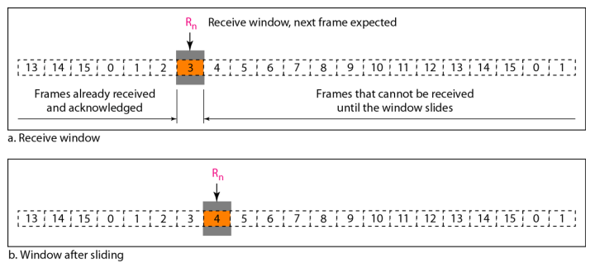

Slide 21
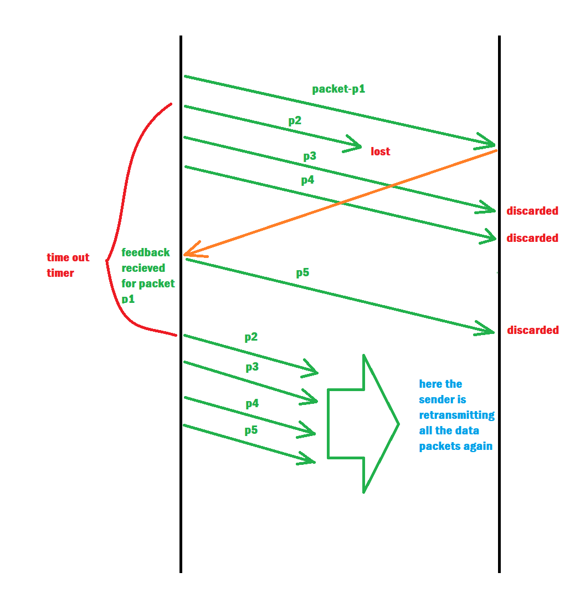

Slide 22
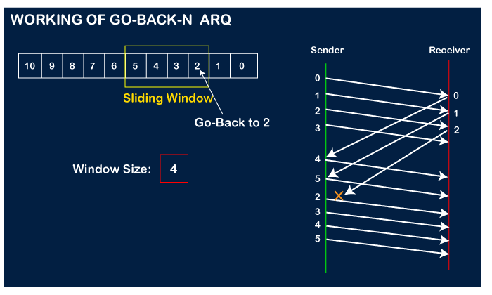

Slide 23
Efficiency of GBN = N/(1+2a)
where a = Tp/Tt
Throughput
= Efficiency * Bandwidth
= (N/(1+2a)) * B

Slide 24
Selective Repeat ARQ Protocol – flow control and error control
The Go-back-N ARQ protocol works well if it has fewer errors. But if there is a lot of error in the frame, lots of bandwidth loss in sending the frames again.
So, we use the Selective Repeat ARQ protocol. In this protocol, the size of the sender window is always equal to the size of the receiver window.
If n bits are available for sequence numbers, then sender window size = receiver window size = 2^{n-1}
SR protocol can send a negative ACK for each corrupted or lost packet. However, this behavior is less common.
SR protocol accepts the out of order frames. SR protocol requires sorting at the receiver’s side.
SR protocol leads to retransmission of unacknowledged frames after expiry of time out timer at the sender.

Slide 25
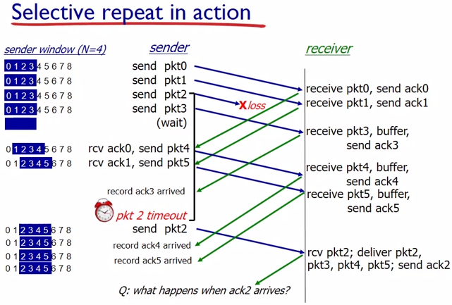

Slide 26
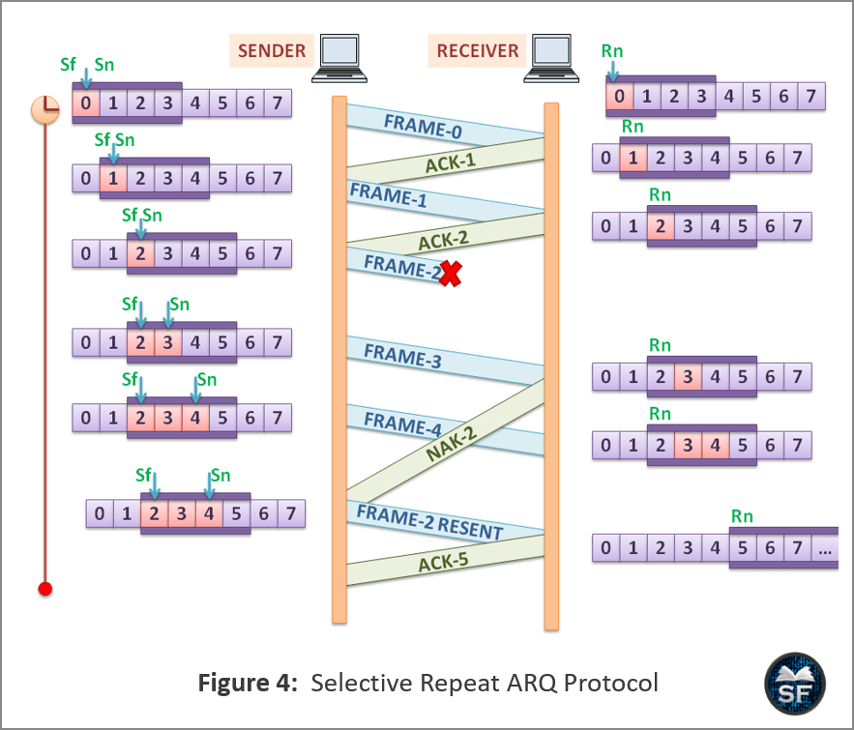

Slide 27
Efficiency = N/(1+2a)
Where a = Propagation delay / Transmission delay

Slide 28
A 20 Kbps satellite link has a propagation delay of 400 ms. The transmitter employs the “go back n ARQ” scheme with n set to 10. Assuming that each frame is 100 bytes long, what is the maximum data rate possible?
5 Kbps
10 Kbps
15 Kbps
20 Kbps
Given-
Bandwidth = 20 Kbps
Propagation delay (T_{p}) = 400 ms
Frame size = 100 bytes
Go back N is used where N = 10

Slide 29
Calculating Transmission Delay-
Transmission delay (T_{t})
= Frame size / Bandwidth
= 100 bytes / 20 Kbps
= (100 x 8 bits) / (20 x 10³ bits per sec)
= 0.04 sec
= 40 msec
Calculating Value Of ‘a’-
a = T_{p} / T_{t}
a = 400 msec / 40 msec
a = 10

Slide 30
Calculating Efficiency-
Efficiency (η)
= N / (1+2a)
= 10 / (1 + 2 x 10)
= 10 / 21
= 0.476
= 47.6 %
Calculating Maximum Data Rate Possible-
Maximum data rate possible or Throughput
= Efficiency x Bandwidth
= 0.476 x 20 Kbps
= 9.52 Kbps
≅ 10 Kbps
Thus, Correct Option is (B)

Slide 31
Consider a 128 x 10³ bits/sec satellite communication link with one way propagation delay of 150 msec. Selective Retransmission (repeat) protocol is used on this link to send data with a frame size of 1 KB. The minimum number of sequence numbers to achieve 100% utilization is ________ .
Given-
Bandwidth = 128 x 10³ bits/sec
Propagation delay (T_{p}) = 150 msec
Frame size = 1 KB
Now,
To achieve 100% utilization, efficiency must be 100%.
Efficiency is 100% when sender window size is optimal i.e. 1+2a
Calculating Transmission Delay-
Transmission delay (T_{t})
= Frame size / Bandwidth
= 1 KB / (128 x 10³ bits per sec)
= (1 x 2¹⁰ x 8 bits) / (128 x 10³ bits per sec)
= 64 msec

Slide 32
Calculating Value of ‘a’-
a = T_{p} / T_{t}
a = 150 msec / 64 msec
a = 2.34
Calculating Optimal Sender Window Size-
Optimal sender window size
= 1 + 2a
= 1 + 2 x 2.34
= ⌈5.68⌉
= 6
Calculating Number Of Sequence Numbers Required-
In SR Protocol, sender window size and receiver window size are same.
So, sender window size = receiver window size = 6
For any sliding window protocol, minimum number of sequence numbers required
= Sender window size + Receiver window size
= 6 + 6
= 12

Slide 33
Min bits required in seq number field-
⌈ log₂ (12) ⌉
= ⌈ 3.585⌉
= 4
Link for more problems on Go Back N:
https://www.gatevidyalay.com/go-back-n-practice-problems/

